Slide 1
Niveles de Evidencia Científica
Maestría en Epidemiología aplicada a la Gerencia de la Salud Pública

Slide 2
Niveles de Evidencia
(U.S. Preventive Services Task Force (USPSTF) )
I: Evidence obtained from at least one properly designed randomized controlled trial
II-1: Evidence obtained from well-designed controlled trials without randomization
II-2: Evidence obtained from well-designed cohort or case-control analytic studies, preferably from more than one center or research group
II-3: Evidence obtained from multiple time series designs with or without the intervention; dramatic results in uncontrolled trials might also be regarded as this type of evidence
III: Opinions of respected authorities, based on clinical experience, descriptive studies, or reports of expert committees

Slide 3
Niveles de Evidencia
(Canadian Task Force)
I: Evidence obtained from at least one properly designed randomized controlled trial
II-1: Evidence obtained from a well-designed cohort or case-control analytic study, preferably from more than one center or research group
II-2: Evidence obtained from comparisons between times or places with or without the intervention
III: Opinions of respected authorities, based on clinical experience, descriptive studies, or reports of expert committees

Slide 4
Niveles de Evidencia
Systematic reviews and meta-analyses
Randomized controlled trials with definitive results (confidence intervals that do not overlap the threshold of a clinically significant effect)
Randomized controlled trials with non-definitive results (a point estimate that suggests a clinically significant effect but with confidence intervals overlapping the threshold for this effect)
Cohort studies
Case-control studies
Cross-sectional surveys
Case reports
Guyatt GH, Sackett DL, Sinclair JC, Hayward R, Cook DJ, Cook RJ. Users’ guides to the medical literature. IX. A method for grading health care recommendations. Evidence-Based Medicine Working Group. JAMA. 13 de diciembre de 1995;274(22):1800-4.

Slide 5
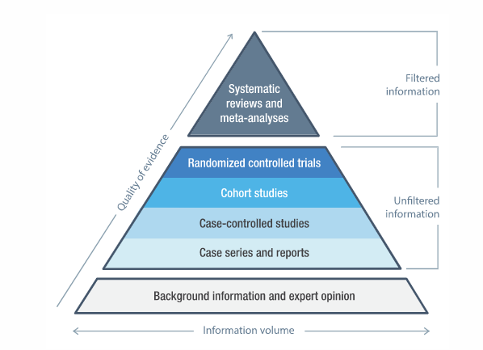
Niveles de Evidencia Científica

